Slide 1
User Access to CenturyLink Data Lake

Slide 2
Contents (topic list really, some items may take more/less than a page)
Overview Diagram
Off Platform Read Only Access
more later
Appendices – for anything
Issue – Files and world readable
Last Update: 4/24/2017

Slide 3
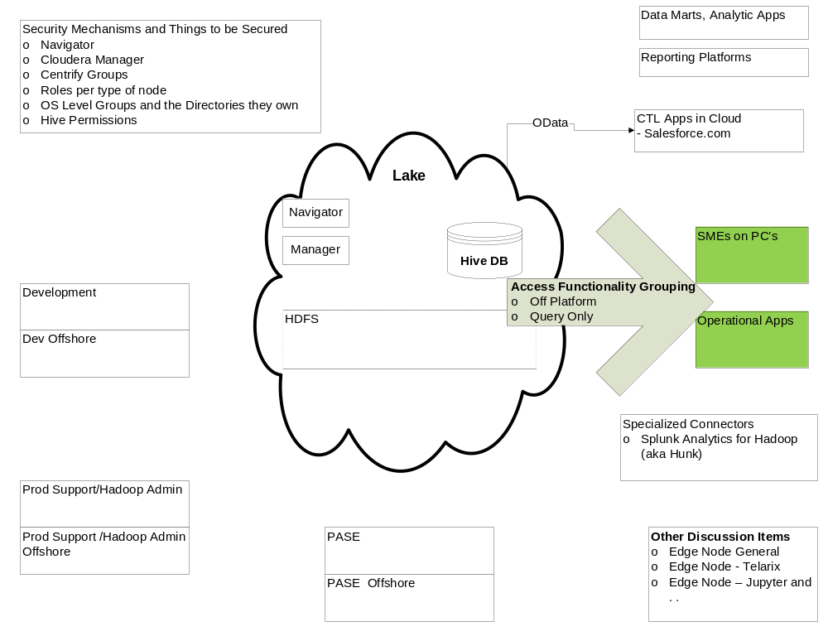
Overview Diagram
Last Update: 4/24/2017

Slide 4
Aside – User Types/Scenarios and Users
In order to create processes for adding users in a secure manner, it is necessary to break things down into different types of users/usage.
  For example – a Business Objects report needs very different security/access than a Production Data Ingestion Application.
However, in the real world, *users*, will be associated with multiple access mechanisms.
  For example - The Business Objects report writer might also be a PC SME type of user and the team they are on will be a production application type of user.
Last Update: 4/24/2017

Slide 5
Off Platform, Query Only Access - Contents
User Types and Expected Usage
Usage Guidelines
Hue Access
Connecting via JDBC and/or ODBC Drivers
Authentication
  require AD account; Kerberos option requires Kerberos client on PC or server where access is coming from. This is our preferred, more secure method. Exceptions will be made (and LDAP username/password will be used) where necessary.
Access Controls
HQL vs SQL
Last Update: 4/24/2017

Slide 6
Off Platform, Query Only Access – User Types and Expected Usage
SME’s on PC’s will include numerous communities:
  Development teams, especially non-IT, non data lake
  Domain SME’s
  Analysts, System Engineers, Architects
  Managers needing light access
80% Use Case
  Exploratory Data Analysis
  Data Usage Prototyping
Last Update: 4/24/2017

Slide 7
Off Platform Read Only Access – Usage Guidelines
Currently, 2 main DBMS “Engines”
  Hive
  Impala
Similarities
  Both use the “Hive Metastore” to define tables
  Both use the same physical data in hdfs
  Both are subsets and extensions of SQL
Differences
  Impala performs significantly better for small, transactional like queries, e.g.:
    Bring back all data for Provisioning Order 123
  Hive performs significantly better for large, batch like queries, e.g.:
    Bring back all Provisioning Orders created yesterday
Last Update: 4/24/2017

Slide 8
Off Platform Read Only Access – Hue Access
Web Browser based – no installation
Impala and Hive Query Editors
Simplest way to access
Best for single query at a time, not for constructing complicated code.
Last Update: 4/24/2017

Slide 9
Off Platform, Query Only Access – Connecting via JDBC and/or ODBC Drivers
Main Reasons for Use:
  Already have an application, written with languages A, B, C.
  Now need access to data in the Lake.
  or
  Already have a preferred data query browser/tool
Cloudera downloads for drivers and the documentation that goes with is located here:
    https://www.cloudera.com/downloads.html
    I am showing the ODBC for Hive documentation in order to show relevant sections that are in all of the documents:
      About – general info
      Installing the Driver on [Windows|Mac|Linux]
        Visual C++ Prerequisite
        Installation
        Creating DSN’s
        Authentication – Kerberos (long term for apps), ID/PW – for individual users
      Features
Last Update: 4/24/2017

Slide 10
Off Platform Read Only Access – Access Controls
Still working – let’s discuss CR6350 data
Last Update: 4/24/2017

Slide 11
Issues
# | Date Opened | Name/Description | Next Steps
1 | 3/1/2017 | Hue Access also gives World Readable access to files. | Discuss
2 | 4/17/2017 | Sharepoint site that hosts DLI Form won’t support non-employee/contractor data entry (e.g. Impetus) | Low Priority – Hold
3 | 4/17/2017 | Can we add AD groups onto the form if the user knows them
4 | 4/17/2017 | Can we add a Role type onto the form | Mick wants to discuss
Last Update: 4/24/2017

Slide 12

Appendices
Last Update: 4/24/2017

